Slide 1
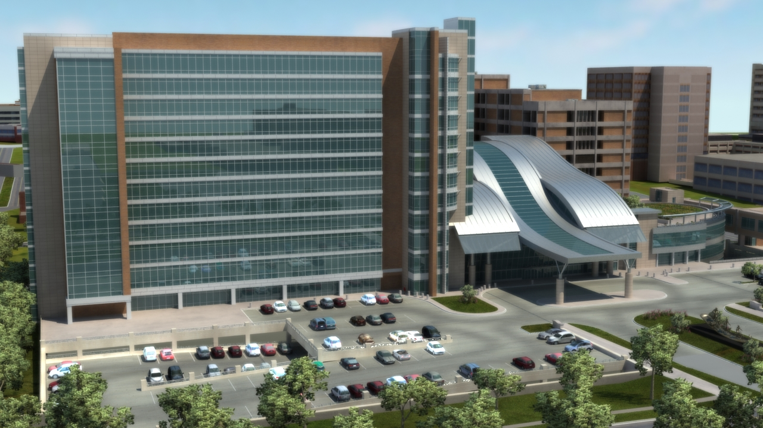
Oklahoma University Children’s Medical Office Building
Jonathan Ebersole Structural Option

Slide 2
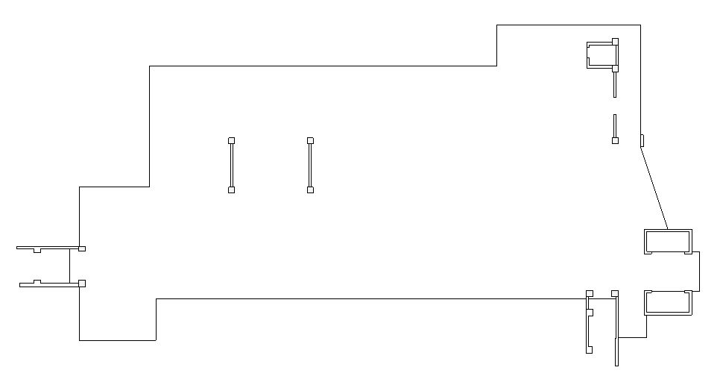
Lateral Force Resisting System
Typical floor plan with the Lateral Force Resisting System
Building uses ordinary reinforced concrete shear walls
Did not analyze the grey walls because there is no load path from the diaphragm into the wall

Slide 3
Critical Walls
Wall C
Wall M
Modeled the critical wall in the North/South direction and East/West direction
Critical because the walls have the most stiffness

Slide 4
Model Assumptions
Base conditions are considered pinned
  Foundations are piers and footings that are not large enough to resist a moment
Diaphragm is considered rigid
  10” two way concrete slab with drop panels
  Built integrally with the columns and lateral elements

Slide 5
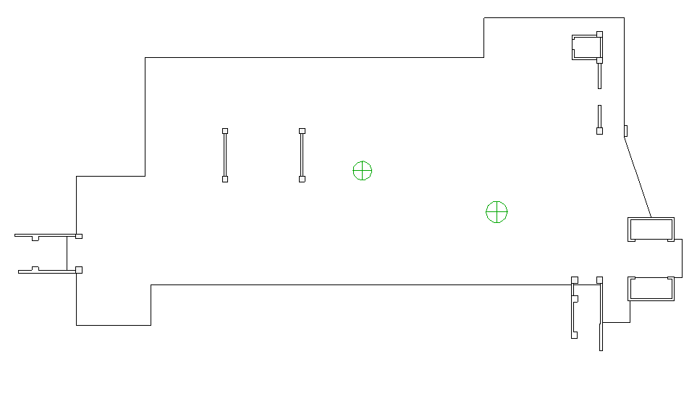
Horizontal Distribution
Center of Mass
Center of Rigidity
The center of mass and the center of pressure are at about the same location
The center of rigidity is different than the center of mass so torsional effects must be applied
Seismic loads are applied at the center of mass
Wind loads are applied at the center of pressure

Slide 6
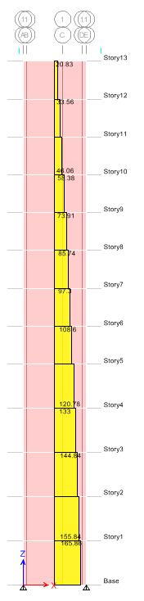
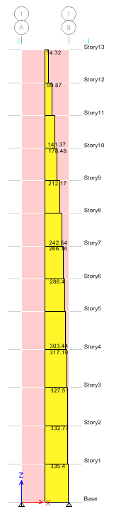
Vertical Distribution
Wall C
Wall M

Slide 7
Animation

Slide 8
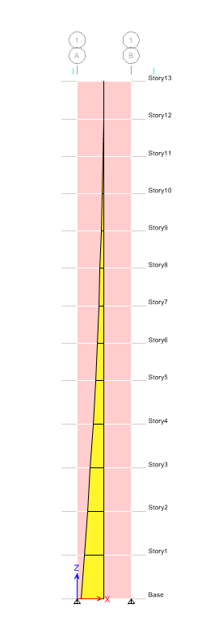
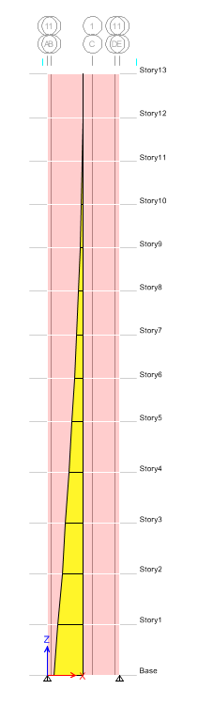
Moment Diagram
Wall C
Wall M

Slide 9
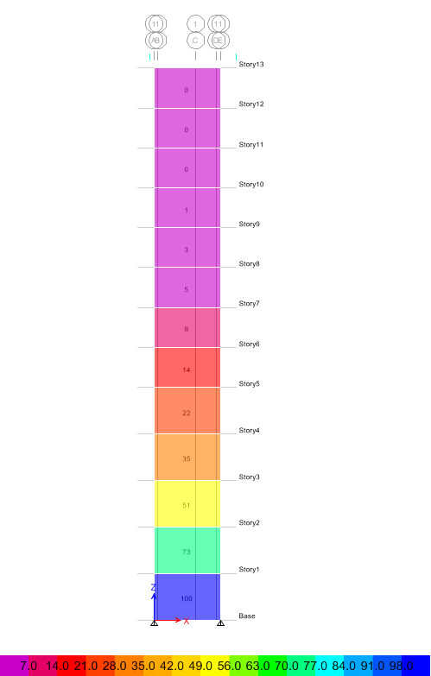
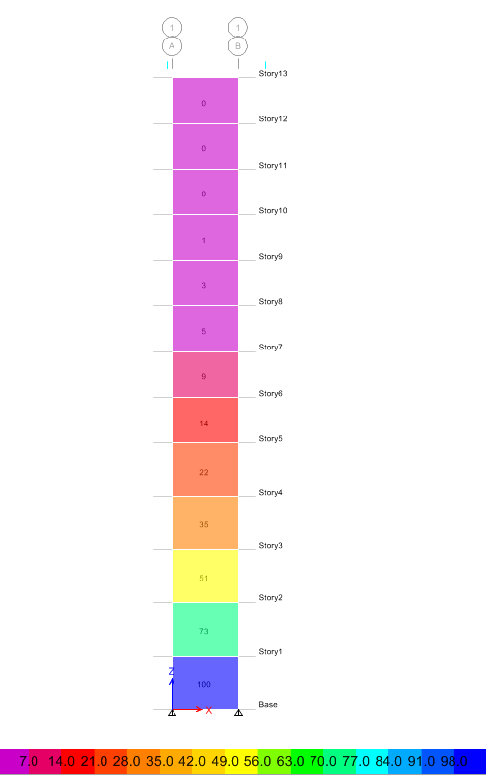
Member Utilization Ratios
Wall C
Wall M

